Slide 1
The Missouri Compromise
of 1820

Slide 2
The dispute was over pro-slavery versus anti-slavery factions in North America
Missouri requested admission to the union as a slave state in 1819

Slide 3
Representatives James Tallmadge and John Taylor of New York proposed amendments to end slavery

Slide 4
The Tallmadge amendment forbade further introduction of slaves into Missouri
It mandated that all children of slave parents born in the state after its admission should be free at the age of 25

Slide 5
The Taylor amendment prohibited slavery in the territories of the Louisiana Purchase Parallel 36 and 1/2 degrees north of the equator

Slide 6
Both the Talmadge and the Taylor amendments were defeated
As a side note, before he was 15 years old, Taylor had read The Federalist Papers

Slide 7
Latitude (shown as a horizontal line ---------) is the distance, in degrees, minutes, and seconds of a point north or south of the Equator
Lines of latitude are often referred to as parallels

Slide 8
Latitude horizontal lines measure north and south
Longitude vertical lines measure east and west

Slide 9
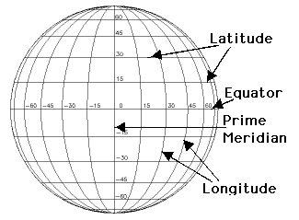

Slide 10
The parallel 36°30′ north is a circle of latitude that is 36 and one-half degrees north of the equator of the Earth

Slide 11
At the time, the United States contained twenty-two states, evenly divided between slave and free
Missouri’s request upset the balance between slave states and free states

Slide 12
The 11 free states in 1820: Illinois, Indiana, Ohio, Pennsylvania, New York, New Jersey, Connecticut, Rhode Island, New Hampshire, Vermont, Massachusetts

Slide 13
The 11 slave states in 1820: Alabama, Delaware, Georgia, Kentucky, Louisiana, Maryland, Mississippi, North Carolina, South Carolina, Tennessee, and Virginia

Slide 14
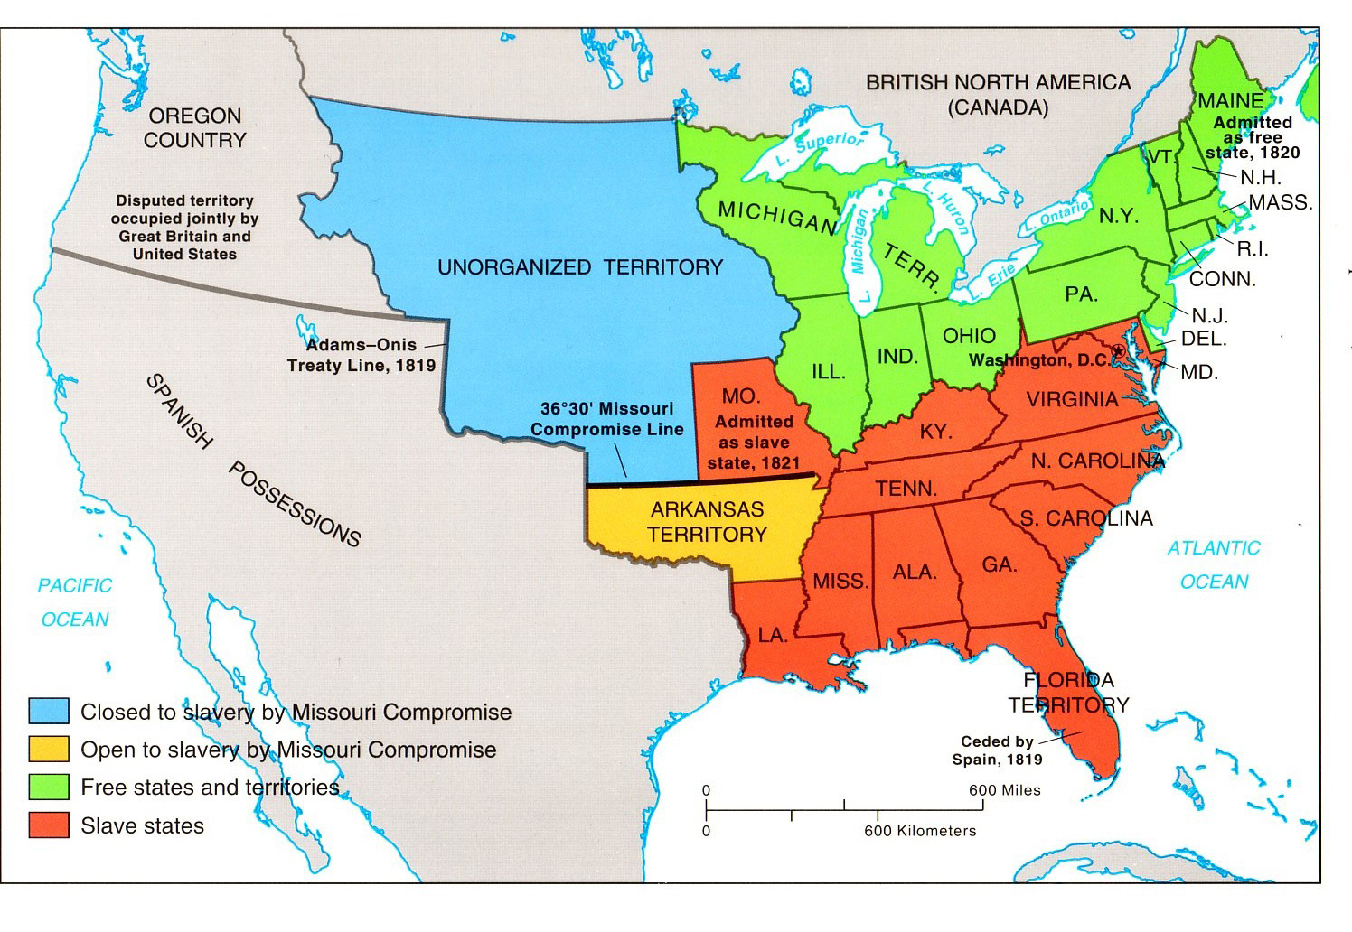

Slide 15
Congress created the two-part compromise called the Missouri Compromise which had 28 sections
Missouri was admitted as a slave state while Maine was admitted as a free state

Slide 16
An Act to Authorize the People of the Missouri Territory to Form a Constitution and State Government, and for the Admission of Such State into the Union on an Equal Footing with the Original States, and to Prohibit Slavery in Certain Territories

Slide 17
The boundary line was a United States federal statute
It was created by Henry Clay

Slide 18
For his work on the Missouri Compromise, Senator Henry Clay became known as the “Great Pacificator”

Slide 19
The Missouri Compromised prohibited slavery in the unorganized territory of the Great Plains
It permitted slavery in Missouri and the Arkansas Territory

Slide 20
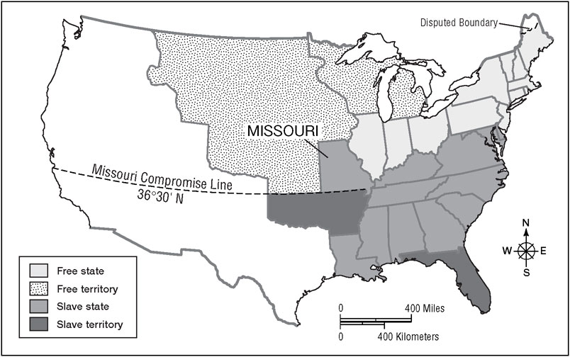

Slide 21
Southerners condemned it because it established the principle that Congress could make laws regarding slavery
Northerners, condemned it for the expansion of slavery (though only south of the compromise line)

Slide 22
The Missouri Compromise helped hold the Union together for more than thirty years

Slide 23
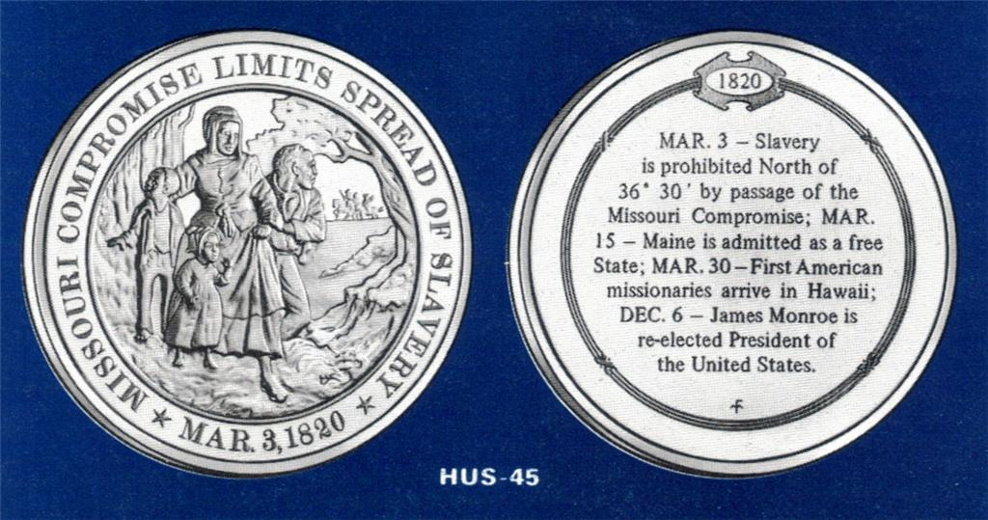

Slide 24
Repealed by the Kansas-Nebraska Act of 1854

Slide 25
Declared unconstitutional in the Dred Scott case by Supreme Court stating Congress was prohibited by the Fifth Amendment from depriving individuals of private property without due process of law

Slide 26
The repeal of the Missouri Compromise continued the equal rights debate that eventually led to the Civil War

